Slide 1
Observations and inferences
21/02/2024
Year 7 Science

Slide 2
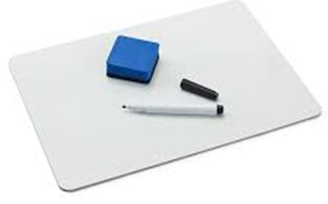
Review:
1. Which units would you use for
Volume
Length
Area
Mass
Force
Time
Temperature

Slide 3
Review:
2. Which equipment would you use for measuring
Volume
Length
Area
Mass
Force
Time
Temperature

Slide 4
Learning Intentions
In fair tests, measure and control variables, and select equipment to collect data with accuracy appropriate to the task

Slide 5
Success criteria
Use measuring equipment safely
Make observations and inferences
Record data in tables

Slide 6
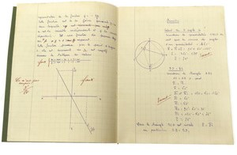
Observations and Inferences 21/02/2024
Observations are made using all five senses, but scientists use sight the most.
Observations can be qualitative (using descriptions) or quantitative (using numbers) such as measurements
Inferences use reasoning or evidence to explain observations or reach conclusions.

Slide 7
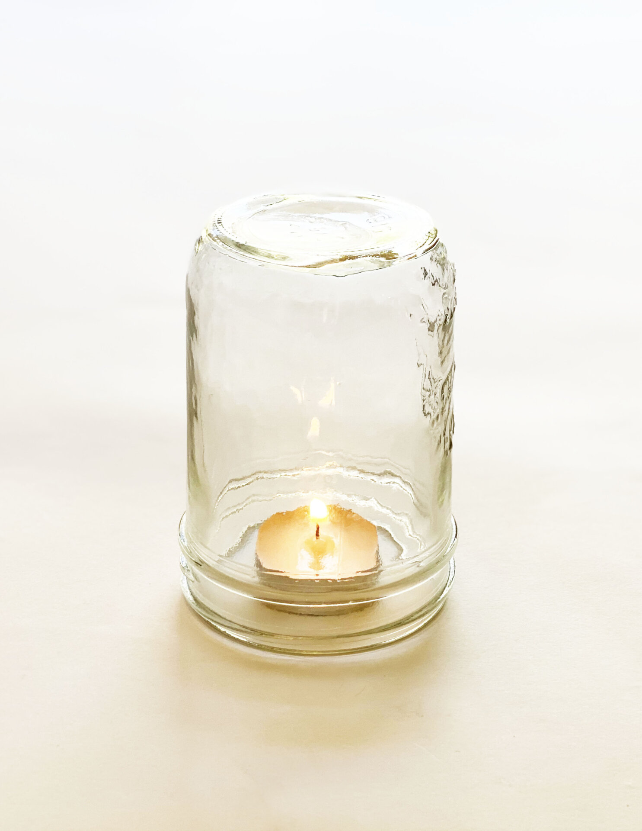
Suffocating candles

Slide 8
Success criteria
Use measuring equipment safely
Use correct units for measurements
Record data in tables

Slide 9
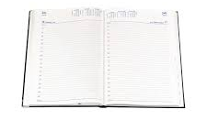
Don’t forget
Homework sheet – laboratory equipment
Due Monday 12 Feb

